Slide 1
9. HTML Injection

Slide 2
목차
HTML Injection 소개
HTML Injection 실습
Injecting User-Agent Header
Injecting Cookie field and Redirecting the page
HTML Injection 예시(고급)

Slide 3


HTML Injection 소개
HTML Injection이란?
취약한 매개변수에 악의적인 HTML 코드를 삽입하는 공격

Slide 4
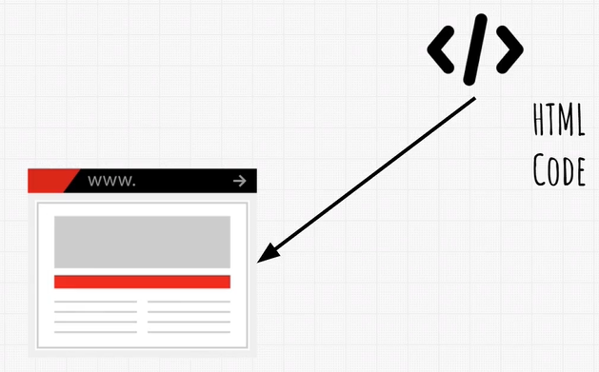
HTML Injection 소개

Slide 5
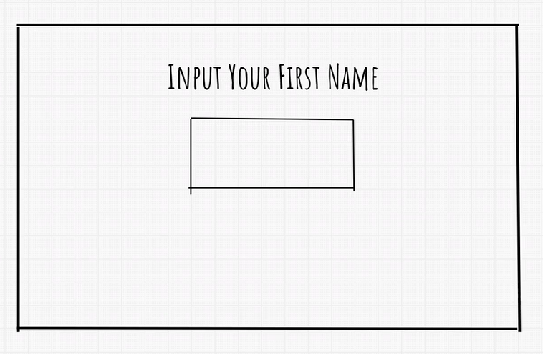



Slide 6
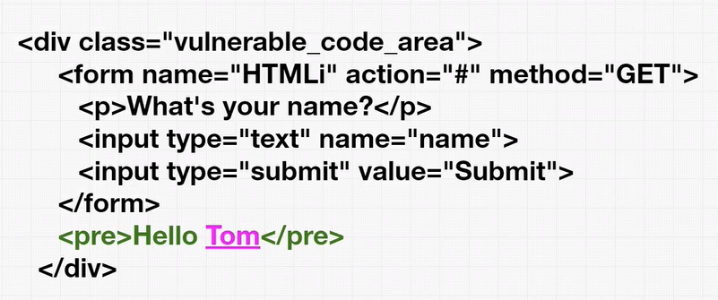

Slide 7
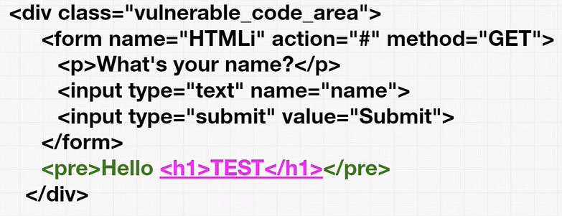
Cadet, <h1>Cadet</h1>, <h1><u>Cadet</u></h1>

Slide 8
Thank You

